Slide 1
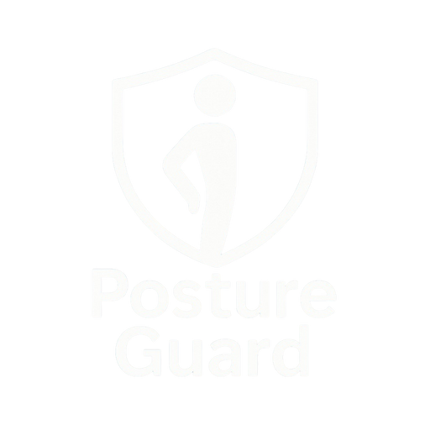

Slide 2





Sign in
Join Now
POSTURE GUARD
01
02
03
Problem
Solution
Revenue Plan
TEAM IGNITRIX

Slide 3


Sign in
Join Now
POSTURE GUARD
01
Problem
Long hours on screens are causing silent posture damage with no active protection.
TEAM IGNITRIX

Slide 4


Sign in
Join Now
POSTURE GUARD
02
Vibrates and sends phone alerts to correct posture.
Builds better habits with subtle feedback.
Companion app offers insights, stretch reminders, and activity suggestions.
Smart wearable that detects slouching in real time.
Solution
Problem
ONLY Rs.5500
TEAM IGNITRIX

Slide 5
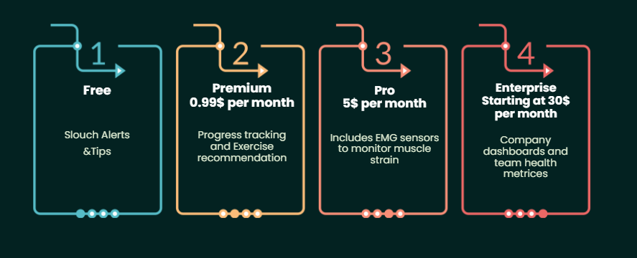
Sign in
Join Now
POSTURE GUARD
03
Revenue Plan
Problem
TEAM IGNITRIX

